Slide 1
Project on : Student Management System

Slide 2
INTRODUCTION
The Console-Based Student Management System is designed to streamline the administration of student data within educational institutions. Its primary purpose is to facilitate efficient management of various student-related processes, including registration, profile management, and secure communication between students and administrators. This system allows users to easily register, log in, view, and update their profiles

Slide 3
Significance
In today's educational landscape, managing student information efficiently is crucial. Traditional methods often involve manual record-keeping, which can lead to errors, delays, and miscommunication. By implementing a centralized management system, we can significantly enhance the following:
Streamlined Registration: Simplifying the enrollment process reduces administrative burdens and ensures that students can easily join the institution.
Efficient Profile Management: Allowing students to update their own information empowers them and ensures that data remains current and accurate.
Improved Communication: Facilitating direct communication between students and administrative staff enhances responsiveness and supports a more engaging educational experience.
Overall, this system addresses the pressing need for organized, secure, and accessible management of student data, ultimately contributing to better educational outcomes and institutional efficiency.

Slide 4
Objectives
Goals of the Student Management System:
To automate administrative tasks.
To provide real-time access to student information.
To enhance communication between students, teachers, and parents.

Slide 5
Features Overview
Core Features:
Registration of new students.
Secure login mechanism.
Profile viewing and updating.
Account deletion option.
User-Focused: Designed for ease of use in a console-based environment.

Slide 6
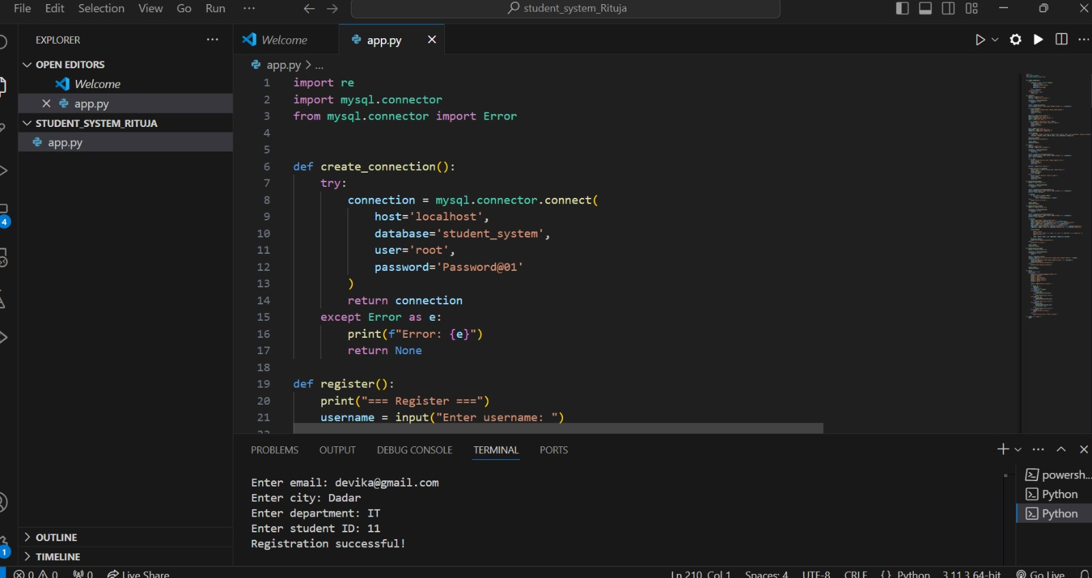
IMPLEMENTATION

Slide 7
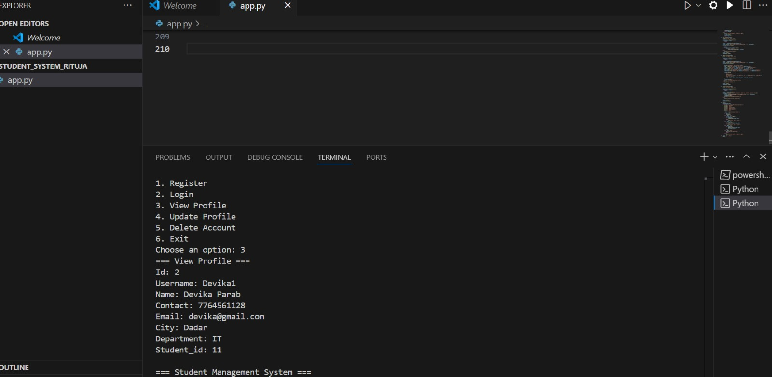
IMPLEMENTATION

Slide 8
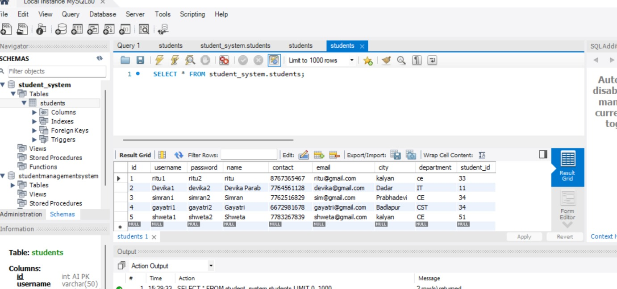
IMPLEMENTATION

Slide 9
Features Overview
Core Features:
Registration of new students.
Secure login mechanism.
Profile viewing and updating.
Account deletion option.
User-Focused: Designed for ease of use in a console-based environment.

Slide 10
Future Enhancements
Additional Features:
Implement password encryption for security.
Expand functionality to include course enrollment and attendance tracking.
Potential migration to a web-based interface for wider accessibility.

Slide 11
Thank you

